Slide 1








Ennove Analytics.co
Entertainment Presentation
Bright TV Viewership Project
Exploring Entertainment, Insights Experience
Presented By:
Innocent Mphahlele

Slide 2





Ennove Analytics.co
Content
1 Introduction
2.Objectives
3. Project Planning & Architecture
4. Key Insights &.Outlining of calculations
5.Data Processing in Databricks
6.Data Analysis in excel
7.Presentation to CEO
8.Recommendations & next steps

Slide 3
Introduction
CEO request
Aim
Bright TV ‘s CEO has an objective to grow the company’s subscription base for this financial year. He has approached analyst to provide insights that would assist CVM (Customer Value Management) team in meeting this year’s objective
Aim of Project is to provide detailed analysis on how subscriptions can be increase viewing its insight
Insights to provide
Provide insights on user and usage trends of Bright TV.
What type of factors influence consumption?
What content would you recommend to increase consumption on the days with low consumption?
What type of initiatives would you recommend to further grow Bright TV ‘s User base.

Slide 4





Project Planning & Architect
Project Statement
Viewers have been declining CEO wants to understand why the
analysis on why the is a decline on revenue
Objective
Following tools were utilized
-MIRO for brainstorming
-Canva for project planning
-Microsoft Excel
-Databricks for Data manipulation & Processing
-Powerpoint presentation for detailed findings

Slide 5
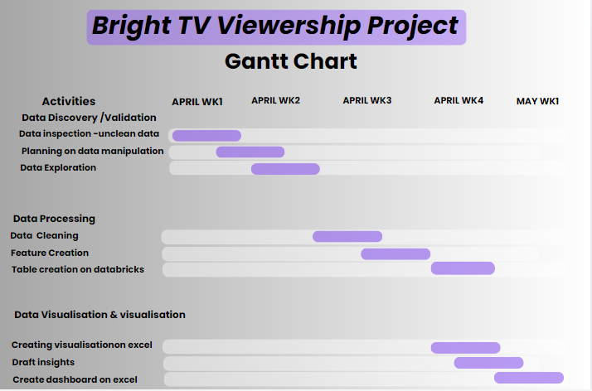
Project Planning-Miro

Slide 6
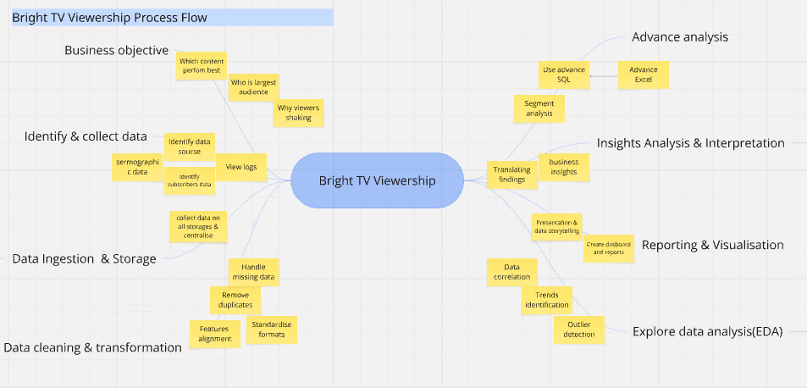
Project Planning-Canva

Slide 7
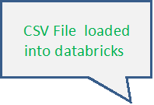
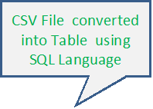
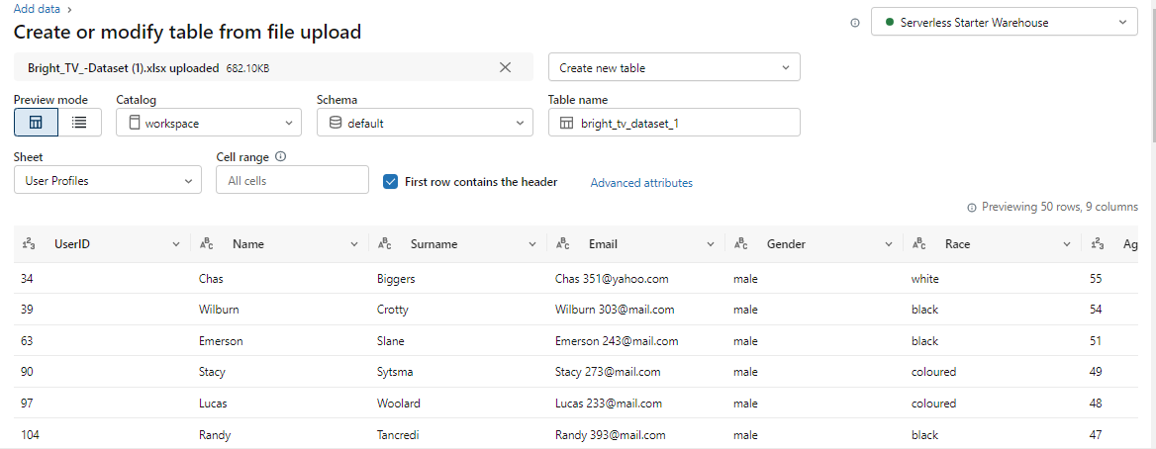
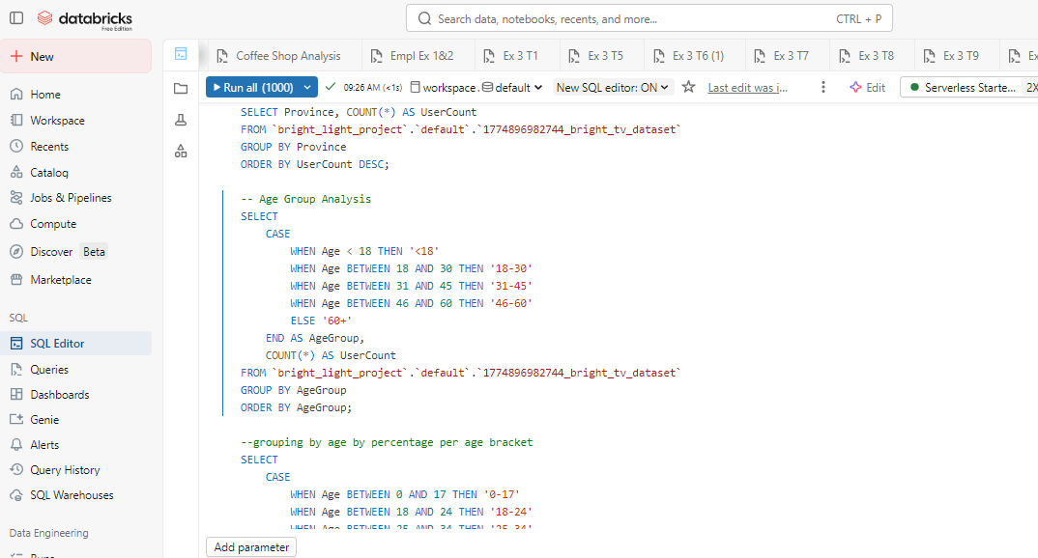
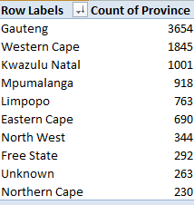
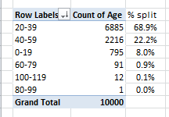
Data insights & exploration

Slide 8
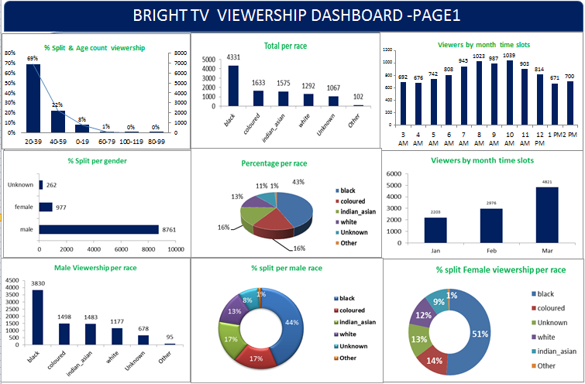
Data Analysis -Excel

Slide 9
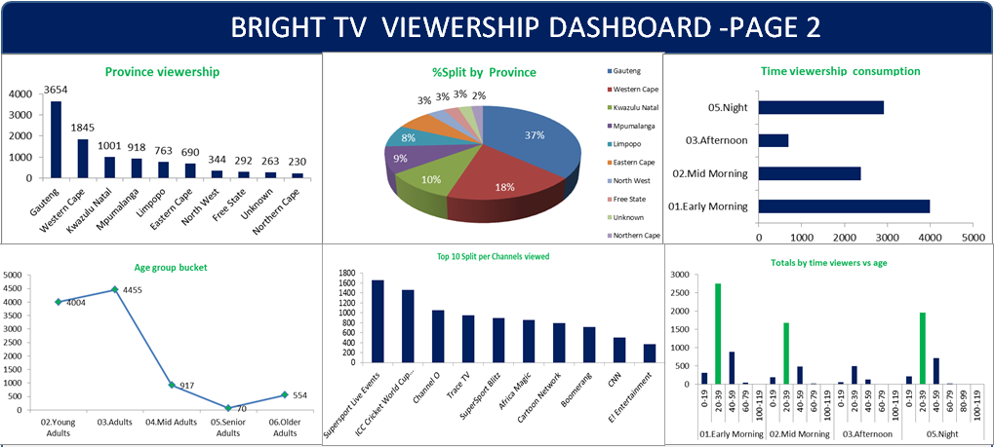
Data Analysis -Excel

Slide 10
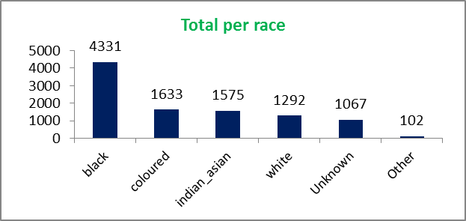
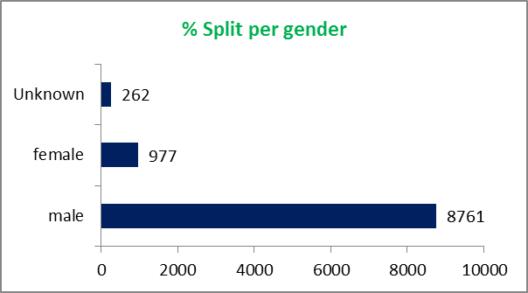
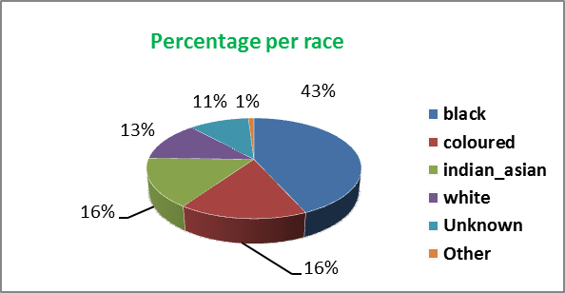
Data Analysis -Excel
Black race highest among the viewers @ 43% followed by coloured community @ 16% as well as indians
-Males are high at 8761, followed by woman ,and some unknown races

Slide 11
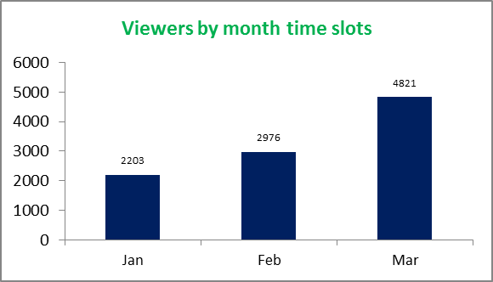
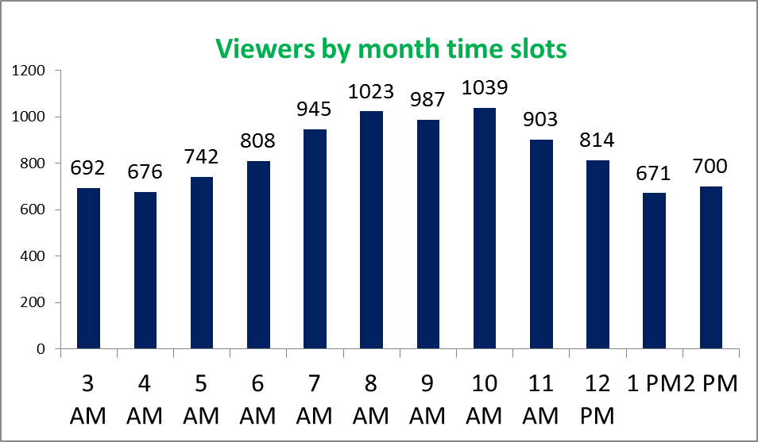
Data Analysis -Excel
Viewers increase or high in March
-viewership by time slots rise around 7-10 AM and start dropping

Slide 12
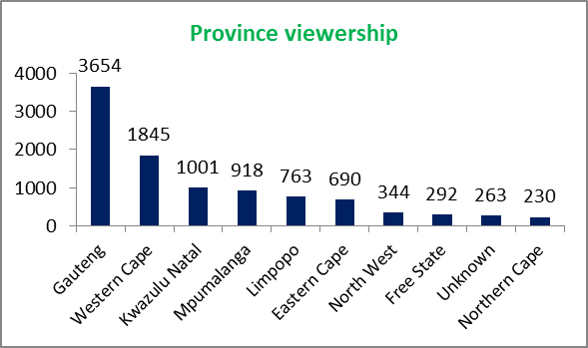
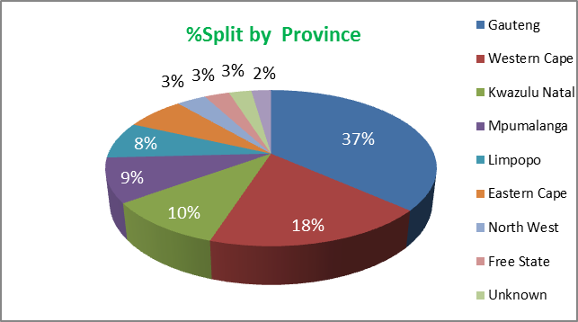
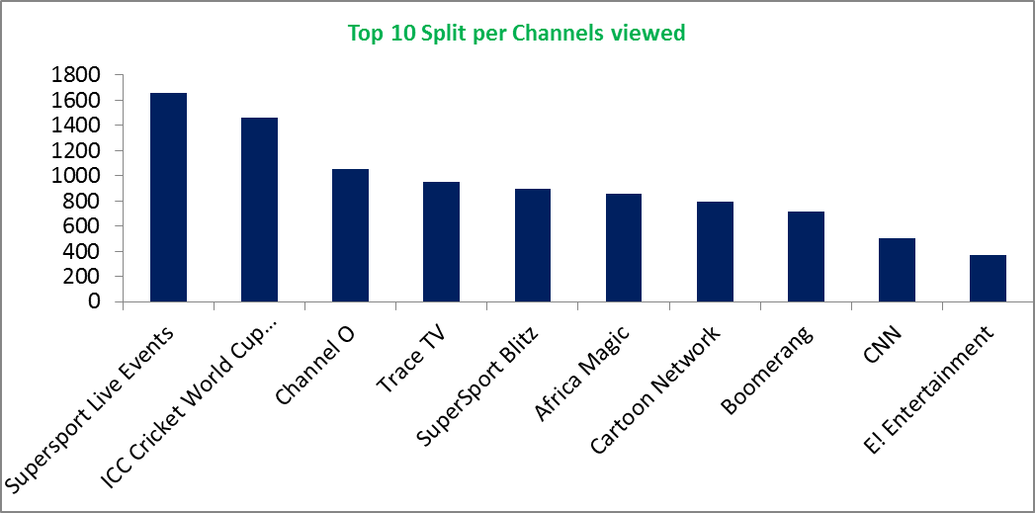
Data Analysis -Excel
Gauteng has the highest viewership followed by WC and then KZN
- 37% Gauteng , 18% WC and KZN 10%
- Most viewed channels is Supersport live events followed by ICC cricket

Slide 13
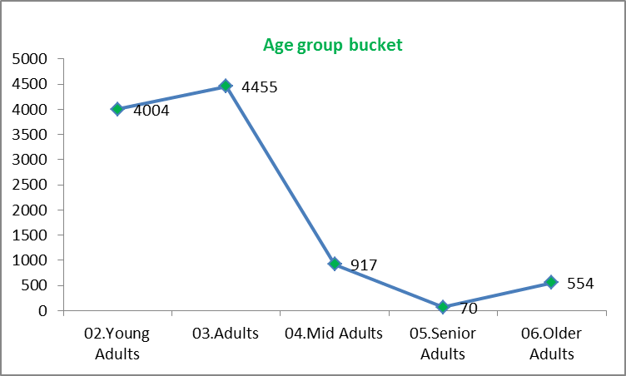
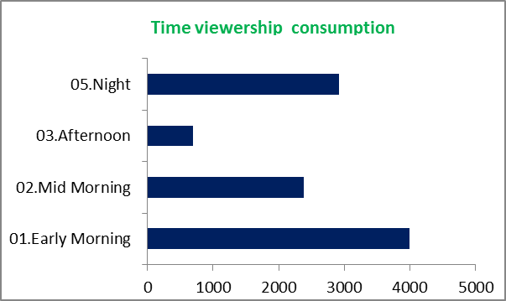
Data Analysis -Excel
-Age group bracket leading in terms of viewing is adults followed by young adults
- Time viewing mostly happens early morning and night

Slide 14
Recommendation & Next steps to take
CONSIDER automating viewers perfomance , behaviour and continously track KPI
-Conduct due-delilgence on audience profile registrations
-Send follow up emails on customers/viewers who don’t complete their profiles to eliminate unknown data
-Investigate on low perfoming platforms why numbers are low ,by creating forms for customers what they think can be improved
-Create a what sup connect where customers will rate service channel perfomance
-Create some discounts to customers who pay less visit to the channels or offer free viewing on channels not in their subscriptions
Packages .
-Increase repeatation of the highest perfoming channels on the low perfoming days
-Do surveys on high perfoming viewership channels , what makes customers /audience pay more attention to them
-Do more marketing on social media advertisements on Tiktok , Facebook ,on website & Twitter .

